Slide 1
Wales Interiors Risk Assessment
Presented By: Akpovona Agbaire
Date: 22/06/2025

Slide 2
Executive Summary
Wales Interiors, a luxury interior design and furniture manufacturing company, is currently undergoing rapid digital transformation. As part of its strategic roadmap, this cybersecurity risk assessment was conducted in line with the ISO/IEC 27001:2022 standards. The assessment uncovered seven critical risks, ranging from cloud misconfigurations and unauthorised access to data to phishing attacks, all of which pose significant business and reputational risks. This report aims to provide actionable insights to guide Wales Interiors in fortifying its security posture, aligning with global standards, and maintaining client trust in a competitive digital economy.

Slide 3
Goal
Our goal was to Identify and assess key cybersecurity risks in Broasted,
Classify risks based on business impact. and recommend mitigation
measures and a clear treatment plan.

Slide 4
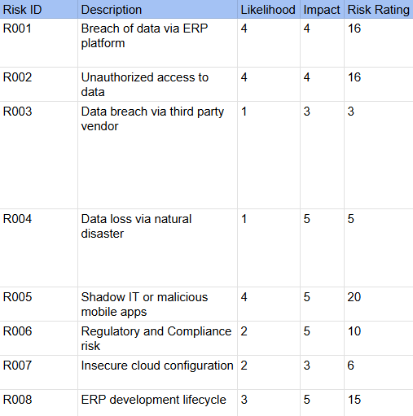
Key Findings
Our biggest weakness is human error. Simple mistakes like weak
passwords or falling for scam emails are the easiest ways for both external hackers and malicious insiders to get their hands on our most valuable data.

Slide 5
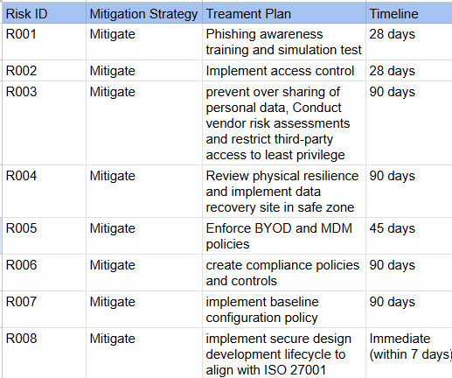
Risk Treatment Plan
Over the next 28 days, we will lock down our systems with stricter access and password rules while training our staff to spot and report threats.

Slide 6
Recommendation
Security Training: Launch mandatory quarterly training and phishing simulation programs for all employees.
Policy Development: Formalize and enforce Acceptable Use, Password,
and Incident Response Policies.
Enhanced Monitoring: Establish centralized logging and monitoring
of user activities and access controls.
Routine Audits: Schedule quarterly access reviews for all sensitive systems and data.

Slide 7
Conclusion
Wales Interiors faces common but serious cybersecurity challenges and failure to act could lead to significant data loss, regulatory fines, and reputational damage but by promptly implementing the proposed recommendations, we can significantly reduce our risk exposure, protect our clients, and strengthen our competitive market position.

